Slide 1
Female Reproductive System
Samar S. Ghazi Lecturer:

Slide 12
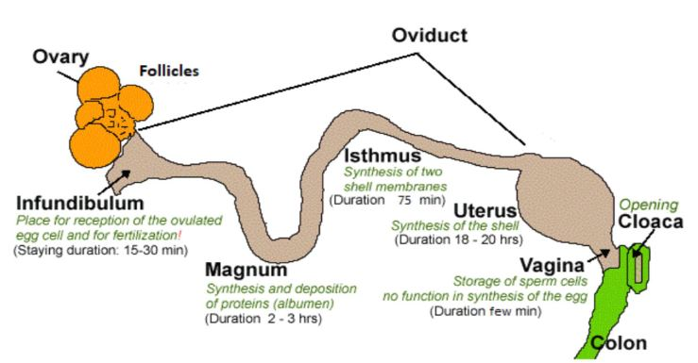

Slide 13
Thank You

